Slide 1

SECURITY TESTING

Slide 2
AGENDA
Understanding client & server architecture
Understanding REST APIs & its attributes
Understanding Response code, Response description, http headers
Understanding OWASP top#10 vulnerabilities
Installing Vooki tool for analysing security headers and vulnerabilities
Installing Wappalyzer for understanding application framework foot print details
Installing Burp Suite community edition
Exploring Burp Suite features
Exploring vulnerability scanner [Burp or ZAP]
Testing sample applications to find security vulnerabilities

Slide 3
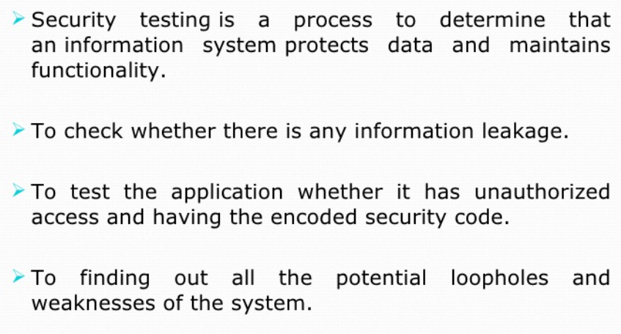
What is security testing

Slide 4
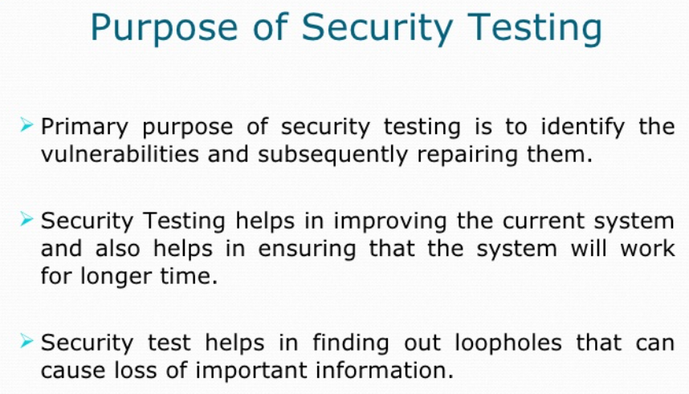

Slide 5
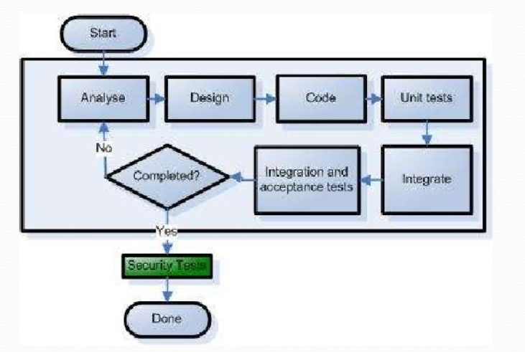

Slide 6
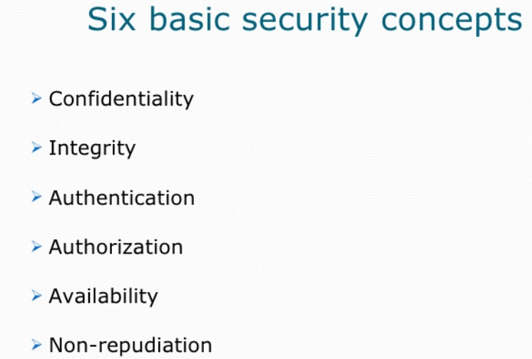

Slide 7
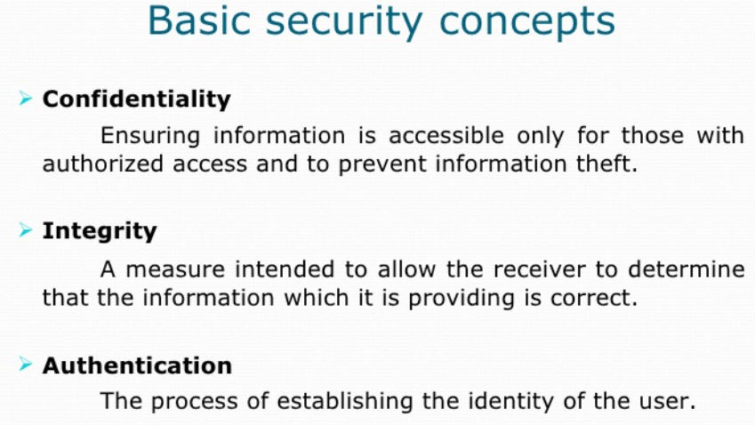

Slide 8
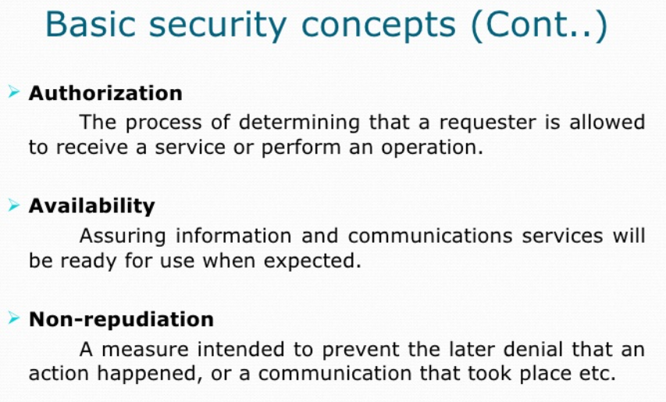

Slide 9
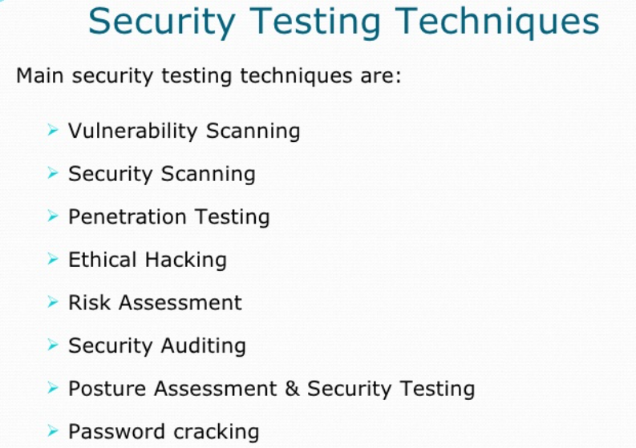

Slide 10
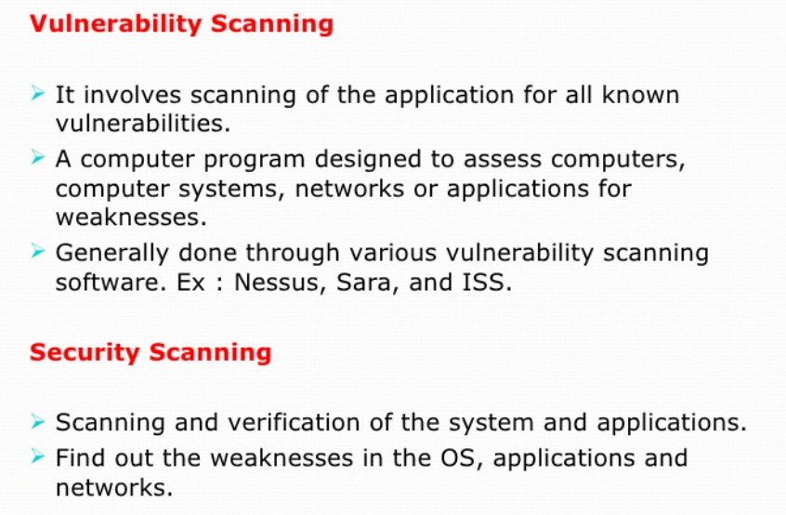

Slide 11
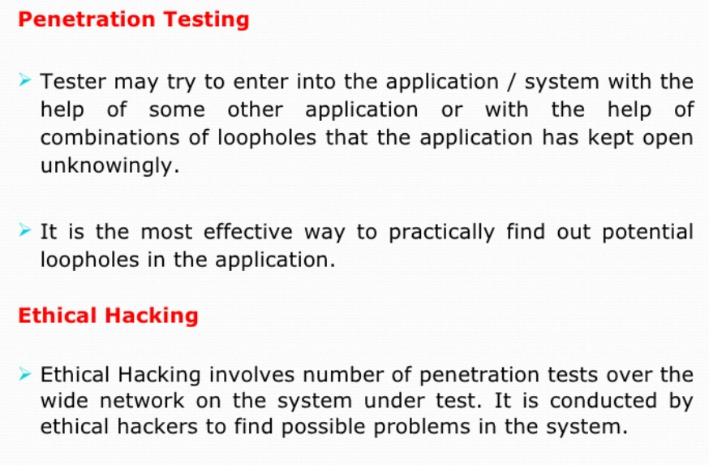

Slide 12
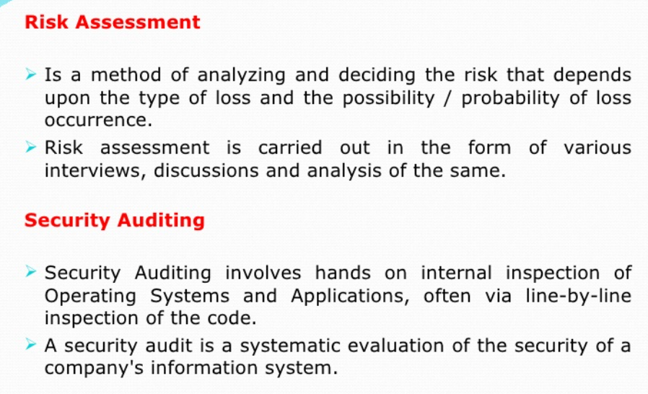

Slide 13
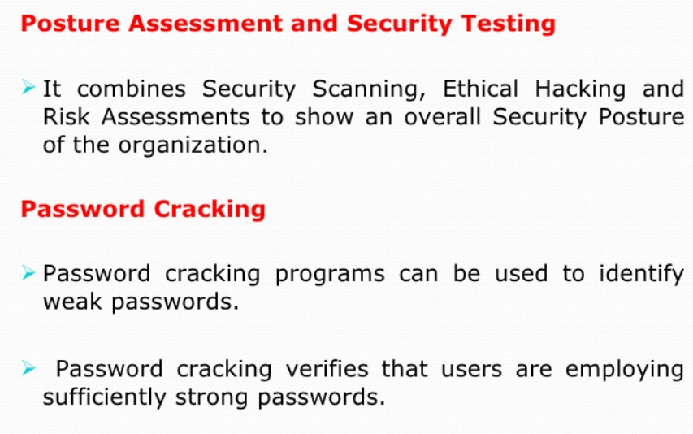

Slide 14
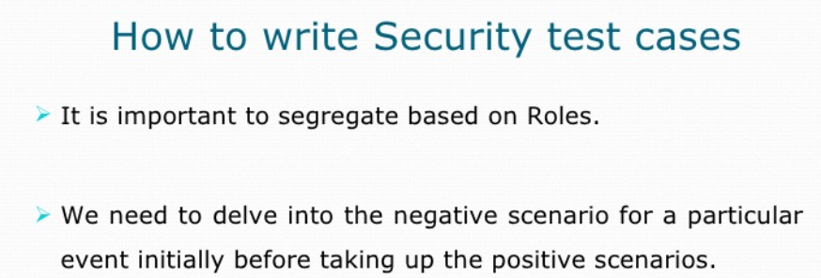

Slide 15
OWASP VULNERABILITIES
WHAT IS OWASP
AGE OF OWASP
CAN WE TRUST OWASP
VULNERABILITIES AS PER OWASP

Slide 16
OWASP VULNERABILITIES
Injection
Injection occurs when an attacker exploits insecure code to insert (or inject) their own code into a program. Because the program is unable to determine code inserted in this way from its own code, attackers are able to use injection attacks to access secure areas and confidential information as though they are trusted users. Examples of injection include SQL injections, HTML command injections etc
Application security testing can reveal injection flaws and suggest remediation techniques such as stripping special characters from user input or writing parameterized SQL queries.

Slide 17
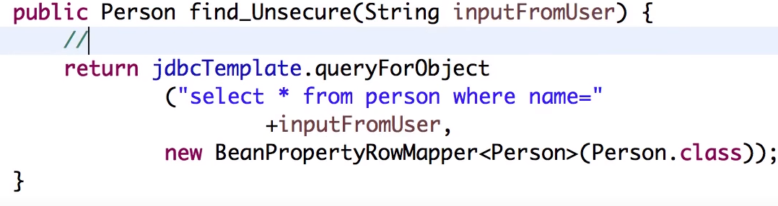
INJECTION

Slide 18
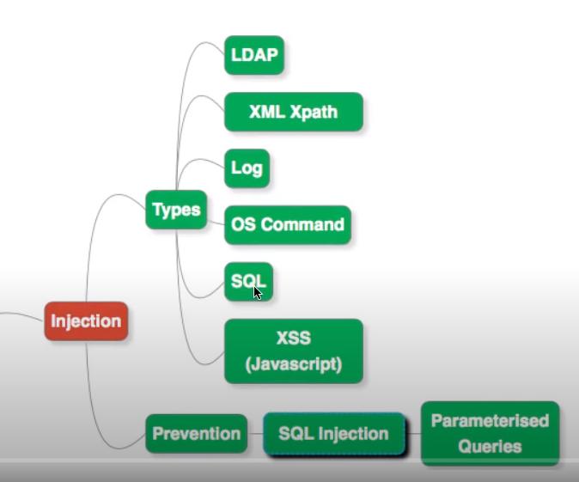
INJECTION

Slide 19
OWASP VULNERABILITIES
Broken Authentication & Session Management
Incorrectly implemented authentication and session management calls can be a huge security risk. If attackers notice these vulnerabilities, they may be able to easily assume legitimate users' identities.
Multifactor authentication is one way to mitigate broken authentication. Implement DAST and SCA scans to detect and remove issues with implementation errors before code is deployed.

Slide 20
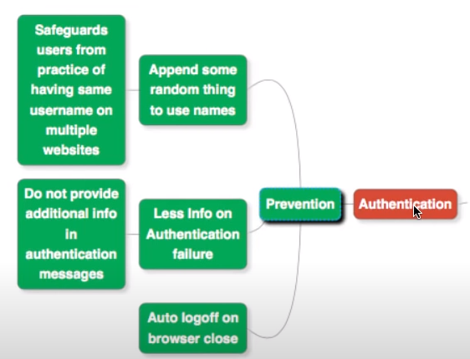
Broken Authentication & Session Management

Slide 21
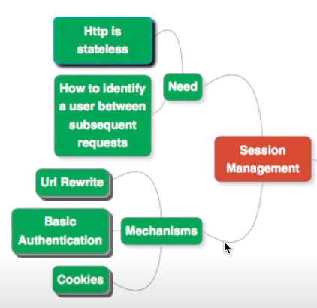
Broken Authentication & Session Management

Slide 22
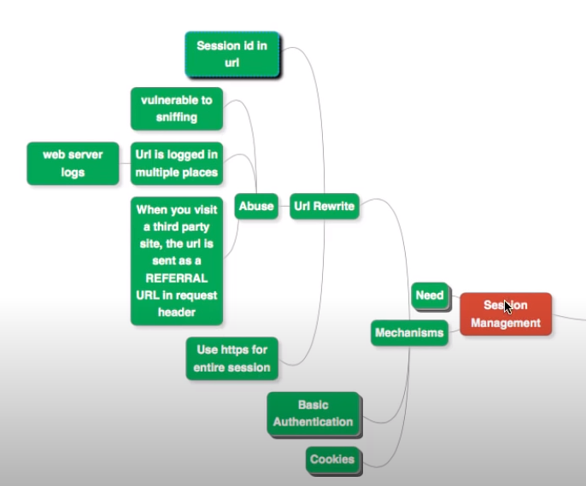
Broken Authentication & Session Management

Slide 23
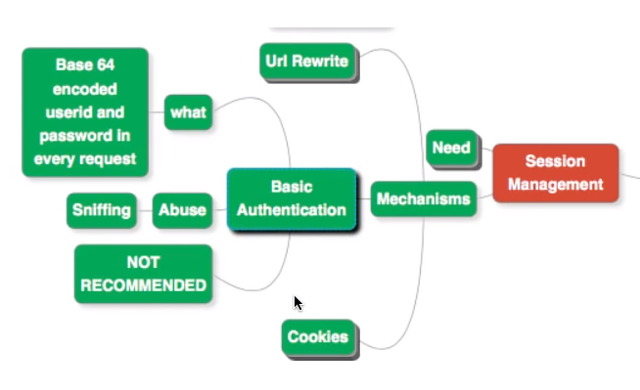
Broken Authentication & Session Management

Slide 24
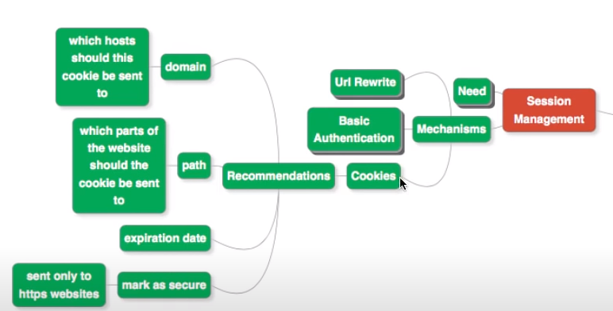
Broken Authentication & Session Management

Slide 25
OWASP VULNERABILITIES
Sensitive Data Exposure
APIs, which allow developers to connect their application to third-party services like Google Maps, are great time-savers. However, some APIs rely on insecure data transmission methods, which attackers can exploit to gain access to usernames, passwords, and other sensitive information.
Data encryption, tokenization, proper key management, and disabling response caching can all help reduce the risk of sensitive data exposure.

Slide 26
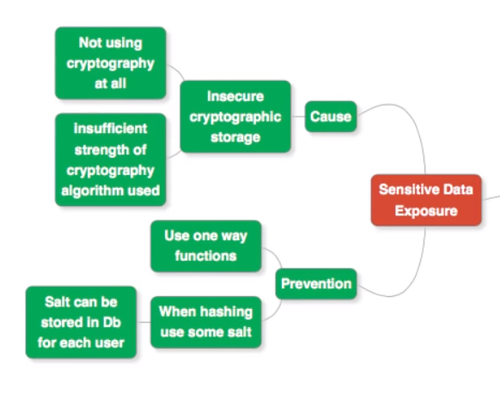
SENSITIVE DATA EXPOSURE

Slide 27
OWASP VULNERABILITIES
INSUFFICIENT TLS

Slide 28
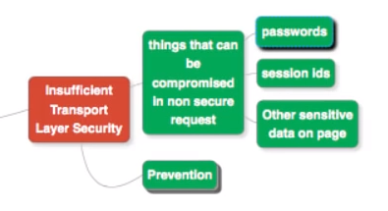
INSUFFICIENT TLS

Slide 29
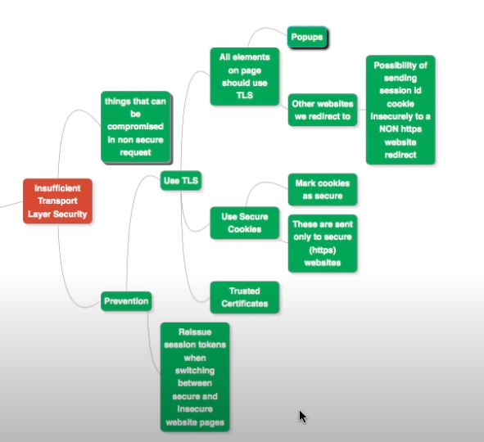
INSUFFICIENT TLS

Slide 30
OWASP VULNERABILITIES
XML External Entities
This risk occurs when attackers are able to upload or include hostile XML content due to insecure code, integrations, or dependencies. An SCA scan can find risks in third-party components with known vulnerabilities and will warn you about them.
Disabling XML external entity processing also reduces the likelihood of an XML entity attack.

Slide 31
OWASP VULNERABILITIES
Broken Access Control
If authentication and access restriction are not properly implemented, it's easy for attackers to take whatever they want. With broken access control flaws, unauthenticated or unauthorized users may have access to sensitive files and systems, or even user privilege settings.
Configuration errors and insecure access control practices are hard to detect as automated processes cannot always test for them. Penetration testing can detect missing authentication, but other methods must be used to determine configuration problems. Weak access controls and issues with credentials management are preventable with secure coding practices, as well as preventative measures like locking down administrative accounts and controls and using multi-factor authentication.

Slide 32
OWASP VULNERABILITIES
Security Misconfiguration
Just like misconfigured access controls, more general security configuration errors are huge risks that give attackers quick, easy access to sensitive data and site areas.
Dynamic testing can help you discover misconfigured security in your application.

Slide 33
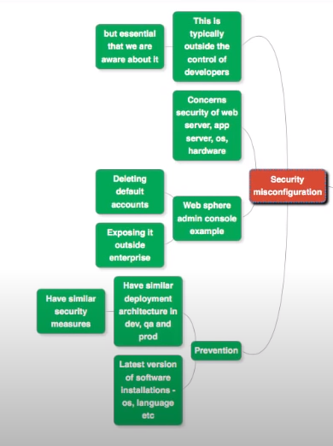
SECURITY MISCONFIGURATION

Slide 34
OWASP VULNERABILITIES
Cross-Site Scripting
With cross-site scripting, attackers take advantage of APIs and DOM manipulation to retrieve data from or send commands to your application. Cross-site scripting widens the attack surface for threat actors, enabling them to hijack user accounts, access browser histories, spread Trojans and worms, control browsers remotely, and more.
Training developers in best practices such as data encoding and input validation reduces the likelihood of this risk. Sanitize your data by validating that it’s the content you expect for that particular field, and by encoding it for the “endpoint” as an extra layer of protection.

Slide 35
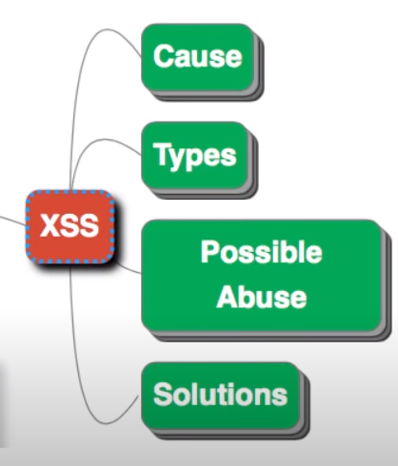
CSS/XSS

Slide 36
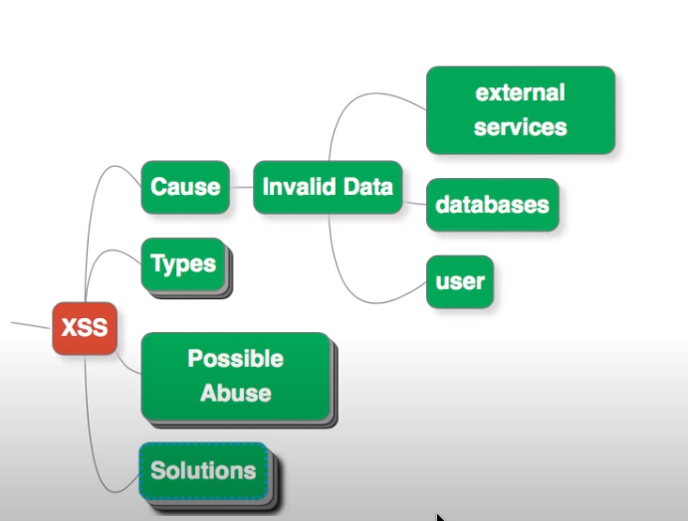
CSS/XSS

Slide 37
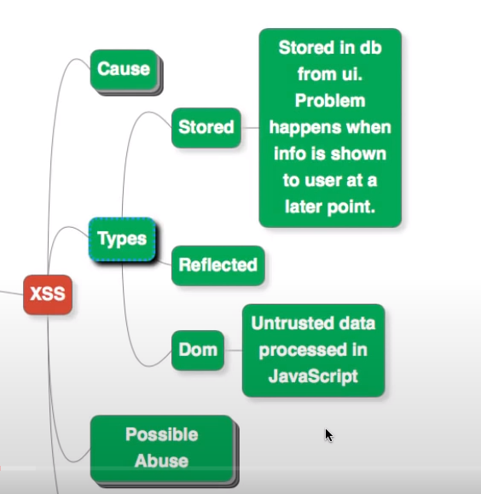
CSS/XSS

Slide 38
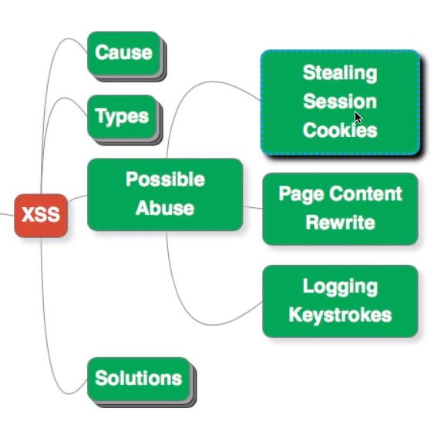
CSS/XSS

Slide 39
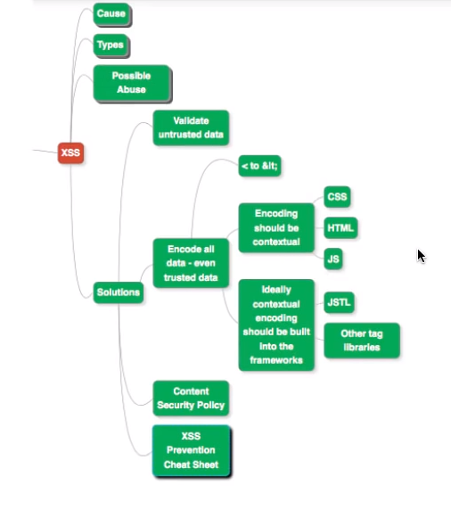
CSS/XSS

Slide 40
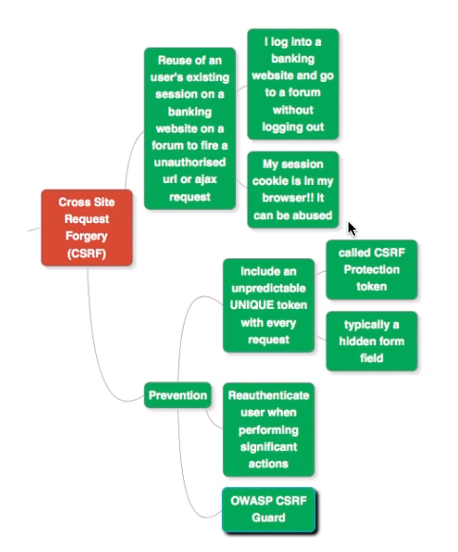
CSRF

Slide 41
OWASP VULNERABILITIES
Using Components with Known Vulnerabilities
No matter how secure your own code is, attackers can exploit APIs, dependencies and other third-party components if they are not themselves secure.
A static analysis accompanied by a software composition analysis can locate and help neutralize insecure components in your application.

Slide 42
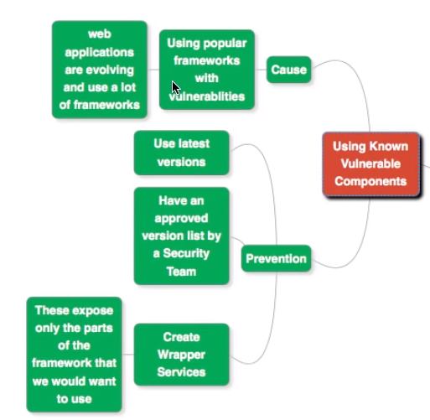
Using components with known vulnerabilities

Slide 43
OWASP VULNERABILITIES
Insufficient Logging and Monitoring
Failing to log errors or attacks and poor monitoring practices can introduce a human element to security risks. Threat actors count on a lack of monitoring and slower remediation times so that they can carry out their attacks before you have time to notice or react.
To prevent issues with insufficient logging and monitoring, make sure that all login failures, access control failures, and server-side input validation failures are logged with context so that you can identify suspicious activity. Penetration testing is a great way to find areas of your application with insufficient logging too. Establishing effective monitoring practices is also essential.

Slide 44
OWASP VULNERABILITIES
Brute Force Attack?
A brute force attack uses trial-and-error to guess login info, encryption keys, or find a hidden web page. Hackers work through all possible combinations hoping to guess correctly.
These attacks are done by ‘brute force’ meaning they use excessive forceful attempts to try and ‘force’ their way into your private account(s).
This is an old attack method, but it's still effective and popular with hackers. Because depending on the length and complexity of the password, cracking it can take anywhere from a few seconds to many years.

Slide 45
OWASP VULNERABILITIES
Insecure Direct Object Reference: A direct object reference occurs when a developer exposes a reference to an internal implementation object, such as a file, directory, or database key. Without an access control check or other protection, attackers can manipulate these references to access unauthorized data.

Slide 46
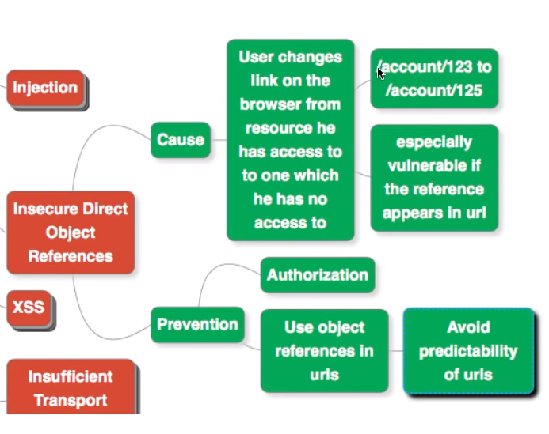
IDOR

Slide 47
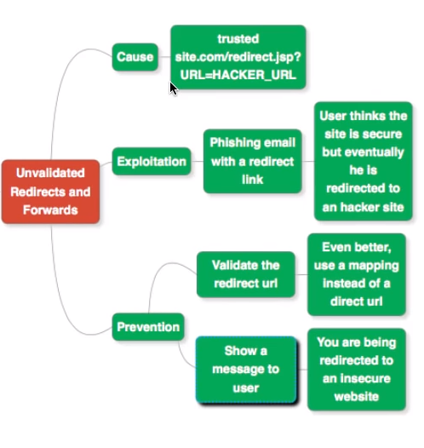
Unvalidated Redirects & Forwards

Slide 48
HTTP HEADERS
REQUEST HEADERS
RESPONSE HEADERS

Slide 49
REST API ATTRIBUTES
HTTP METHOD
HTTP PROTOCOL
BASE URL/HOST
END POINT
QUERY PARAMETERS
REQUEST BODY
AUTHORIZATION
COOKIES

Slide 50
Foot Print details of any web application or REST API
Wappalyzer
What Runs
Shodan [port number, reverse IP mapping to domain name]

Slide 51
Security Headers Testing
Vooki Tool
Mozilla Observatory

Slide 52
Smoke Test Security Testing
Launch the below tool on any browser: http://observatory.allizom.org/
Input a RESTful API
Scan the API
Observe the test results
Generate API smoke security test report from the 3rd party tests tab
Discuss with Developer on the test results and fixes needed

Slide 53
Smoke Test API Headers Security Testing
Launch the below tool on any browser: https://securityheaders.com/
Input a RESTful API
Scan the API
Observe the test results
Discuss with Developer on the test results and fixes needed

Slide 54
Smoke Test to capture Ports Details
Install chrome app : shodan
Execute a GET API on browser
Launch shodan chrome app
Click on IP details
Observe the test results
Discuss with Developer on the test results and fixes needed

Slide 55
Smoke Test Security Testing
Vooki Tool installation
Vooki Tool launch
Creating a project
Add RESTful API’s that uses GET, POST, PUT, DELETE methods
Scan the APIs
Observe the test results
Generate API smoke security test report

Slide 56
Burp Suite
What is Burp Suite
Versions available
Lets go with Burp Suite-Community Edition
Download & Installation of Burp Suite
Walk-through of Burp Suite features
Installation of Burp Suite certificate for https testing

Slide 57
Burp Suite Proxy
Proxy setup
Interceptor
HTTP History
Options

Slide 58
Burp Suite other features
Intruder
Repeater
Extender
Bapp Store
Decoder

Slide 59
Quick Assignment#1
Visit a vulnerable website
Try to crack the UN & PWD
Login to the application
url: https://demo.testfire.net/login.jsp
Hint: Refer Security Misconfiguration vulnerability & Brute Force attack

Slide 60
Quick Assignment#2
Visit a vulnerable website
Try to exploit CSS/XSS vulnerability
url: https://demo.testfire.net/login.jsp
Hint: Use CSS/XSS payloads

Slide 61
Quick Assignment#3
Visit a vulnerable website
Find out which text fields are CSS/XSS vulnerable or not sanitizing the data and passing it as it is to back-end
url: https://demo.testfire.net/login.jsp
Hint: Use CSS/XSS payloads

Slide 62
Quick Assignment#4
Visit a vulnerable website
Steal the cookie using CSS/XSS attack in front-end and back-end url: https://demo.testfire.net/login.jsp
Hint: Use CSS/XSS payloads

Slide 63
Quick Assignment#5
Visit a vulnerable website
Find out if application throws any hints or clues on technical errors, when user inputs invalid test data
url: https://demo.testfire.net/login.jsp
Hint: Use sql payloads at login form

Slide 64
Quick Assignment#6
Visit a vulnerable website
Login into the application using sql injection vulnerability/attack
url: https://demo.testfire.net/login.jsp
Hint: Use sql payloads at login form ‘ OR 1=1 -- ; 1=1

Slide 65
Quick Assignment#7
Visit a vulnerable REST API
Login using REST API & sql injection vulnerability/attack
Get the REST API from website
Hint: Use sql payloads at login form ‘ OR 1=1 -- ; 1=1

Slide 66
HACK-TIP#1
Use Burp Store → Install Hack Bar → Explore it against previous assignments
Use any web application to
inject SQL injection and login
inject XSS payload and execute

Slide 67
HACK-TIP#2
Use Burp Store → Install XSS validator → Explore it against previous assignments

Slide 68
HACK-TIP#3
Use Burp Store → Install Content type converter → Explore it against previous assignments
Try to login to demo.testfire.net by changing content-type to xml

Slide 69
HACK-TIP#4
Use Burp Store → Install SSL scanner & Jython jar seperately → Explore it against previous assignments

Slide 70
HACK-TIP#5
Use Burp Store → Install Postman integration app → Explore it against previous assignments

Slide 71
HACK-TIP#6
Use Burp Store → Install WordList Extractor app → Explore it against previous assignments

Slide 72
HACK-TIP#7
Use Burp Store → Install HTTP Methods Discloser app → Explore it against previous assignments

Slide 73
Quick Assignment#7
Use another vulnerable web application/API and crack the password by using known username
URL: http://testphp.vulnweb.com/login.php
Hint: use Hack bar ; UN: admin or test ; pwd: hack it using sql injection

Slide 74
Quick Assignment#8
Find XSS/CSS vulnerability
URL: http://testphp.vulnweb.com/login.php
Hint: use Hack bar

Slide 75
Quick Assignment#9
Find File traversal attack
URL: http://testphp.vulnweb.com/login.php
Hint: use Hack bar

Slide 76
Quick Assignment#10
The username known is test. Can you login as admin? If yes, crack it
URL: http://testphp.vulnweb.com/login.php
Hint: use Hack bar

Slide 77
Quick Assignment#11
The username known is admin. Can you login as test[? If yes, crack it
URL: http://testphp.vulnweb.com/login.php
Hint: use Hack bar

Slide 78
Vulnerability Scanner applications
Vooki tool
Security Headers tool
Burp Suite Professional or Enterprise edition
OWASP ZAP tool [Zed Attack Proxy]
Other tools etc

Slide 79
Quick Assignment#1
Use a scanner tool to find web or API vulnerabilities
After the vulnerabilities are discovered, check if they are false positives or false negatives

Slide 80
False Positives & False Negatives
Discuss on
False Positive
False Negative
True Positive
True Negative

Slide 81
Find RESTful API vulnerabilities
Use Protocol tampering

Slide 82
Find API vulnerabilities
End Point/Query Param sniffing/smuggling/tampering

Slide 83
Find API vulnerabilities
Request Body tampering

Slide 84
Find API vulnerabilities
Content Type tampering

Slide 85
Find API vulnerabilities
HTTP Method conversion/tampering

Slide 86
Find API vulnerabilities
Content Type conversion/tampering

Slide 87
Find API vulnerabilities
Authorization Token-brute force attacks

Slide 88
Find API vulnerabilities
Authorization-Basic Auth brute force attacks

Slide 89
Find API vulnerabilities
Authorization-Digest Auth brute force attacks

Slide 90
Assignment#0
Use a REST API, check if the token is broken or session mgmt. is not implemented
Hint: Use an expired token after generating a new token for the REST APIs

Slide 91
Assignment#1
Visit https://demo.testfire.net/
Hack the login credentials
[hint: first hack the username and later password using brute-force attacks]

Slide 92
Assignment#2
Visit https://demo.testfire.net/
Hack the password when user name is known
[hint: hack the password using SQL injection ; use hackbar]

Slide 93
Assignment#3
Visit https://demo.testfire.net/
Find XSS vulnerability in front-end & back-end application
[hint: search field before login & after login]

Slide 94
Assignment#4
Visit https://demo.testfire.net/
Find file traversal/directory listing vulnerability, after login
[hint: use categories, pictures section]

Slide 95
Assignment#5
Visit http://brutelogic.com.br/xss.php
Find XSS vulnerability in the URL load
[hint: use hackbar or github payloadsallthethings for xss vectors or
http://brutelogic.com.br/xss.php/%22%3E%3Csvg%20onload=alert(1)%3E ]

Slide 96
Assignment#6
Visit http://testphp.vulnweb.com/artists.php?artist=1
Break the URL to find sql error
[hint: use ‘ in the end and try]

Slide 97
Assignment#7
Visit http://testphp.vulnweb.com/artists.php?artist=1
Break the URL to find sql error
[hint: use order by 1 in the URL end and try]

Slide 98
Assignment#8
Visit http://testphp.vulnweb.com/artists.php?artist=1
Break the URL to find sql error
[hint: use order by 2, 3, 4, 5 in the URL end and understand what info is revealed]

Slide 99
Assignment#9
Visit http://testphp.vulnweb.com/artists.php?artist=1
Find the # of tables
[hint: click on an artist id and see the # of tables ; artist r4w8173, view pictures of the artist, comment on this artist ➔ there are 3 tables]
Let’s penetrate more inside using union base injection to select statement from a different table.
http://testphp.vulnweb.com/artists.php?artist=1 union select 1,2,3
From the screenshot, you can see it is show result for only one table not for others.

Slide 100
Assignment#10
Visit http://testphp.vulnweb.com/artists.php?artist=1
Can you find out other 3 tables by using union+select statement
[hint: try union statement & select statement]
Let’s penetrate more inside using union base injection to select statement from a different table.
http://testphp.vulnweb.com/artists.php?artist=1 union select 1,2,3
From the screenshot, you can see it is show result for only one table not for others.

Slide 101
Assignment#11
Visit http://testphp.vulnweb.com/artists.php?artist=1
Can you find out other 3 tables by using union+select statement and trying with invalid artist id
[hint: try union statement & select statement]
Now try to pass wrong input into the database through URL by replacing artist=1 from artist=-1 as given below:
http://testphp.vulnweb.com/artists.php?artist=-1 union select 1,2,3
Hence you can see now it is showing the result for the remaining two tables also.

Slide 102
Assignment#12
Visit http://testphp.vulnweb.com/artists.php?artist=1
Can you find out the database name
[hint: try union statement & select statement]
http://testphp.vulnweb.com/artists.php?artist=-1 union select 1,database(),3
From the screenshot, you can read the database name acuart

Slide 103
Assignment#13
Visit http://testphp.vulnweb.com/artists.php?artist=1
Can you find out the database version & username
[hint: try union statement & select statement]
http://testphp.vulnweb.com/artists.php?artist=-1 union select 1,version(),current_user()
Here we have retrieve 5.1.73 0ubuntu0 10.04.1 as version and acuart@localhost as the current user

Slide 104
Assignment#14
Visit http://testphp.vulnweb.com/artists.php?artist=1
Can you find out the table name
[hint: try union statement & select statement]
http://testphp.vulnweb.com/artists.php?artist=-1 union select 1,table_name,3 from information_schema.tables where table_schema=database() limit 0,1
From the screenshot you read can the name of the first table is artists

Slide 105
Assignment#15
Visit http://testphp.vulnweb.com/artists.php?artist=1
Can you find out the 2nd table name
[hint: try union statement & select statement]
http://testphp.vulnweb.com/artists.php?artist=-1 union select 1,table_name,3 from information_schema.tables where table_schema=database() limit 1,1
From the screenshot you can read the name of the second table is carts

Slide 106
Assignment#16
Visit http://testphp.vulnweb.com/artists.php?artist=1
Can you find out the 3rd table name
[hint: try union statement & select statement]
http://testphp.vulnweb.com/artists.php?artist=-1 union select 1,table_name,3 from information_schema.tables where table_schema=database() limit 2,1
We got table 3: categ

Slide 107
Assignment#17
Visit WebGoat vulnerable application
Use Forgot Pwd module → Guess the username, then secret question & crack the password
[hint: try Burp Intruder]

Slide 108
Assignment#18
Visit WebGoat vulnerable application
Use Multi Level Login→ send the credentials of a particular user but get authenticated as another user
[hint: try Burp Intercept and change name parameter]

Slide 109
Assignment#19a
Visit WebGoat vulnerable application
SQL Injection Intro → lesson #9 → crack the solutions
[hint: try sql pay loads]

Slide 110
Assignment#19b
Visit WebGoat vulnerable application → Try authentication by pass attack → 2FA authentication vulnerability → crack secret questions and change your password
[hint: try burp intercept, repeater]

Slide 111
JWT – JSON WEB TOKENS
What is JWT
Why are they used
Where are they used
Parts of a JWT
JWT uses Base64url encoding
Debugging JWT token
Jwt.io/#debugger.io

Slide 112
JWT – JSON WEB TOKENS
Vulnerabilities in JWT
application doesn’t verify signature
NONE algorithm
Changing the alg from RS256 to HS256

Slide 113
Assignment#20
Visit WebGoat vulnerable application
Broken Auth → JWT tokens → lesson#4 → hack the JWT token → reset the votes as tom
[hint: change alg to none ; remove signature ; change claim from admin false to true ; change = to %3d in converted jwt token]

Slide 114
Burp Extensiosn
Use JSON Web Tokens
Use JWT Brute
Use JOSEPH/JSON web token attacker

Slide 115
Assignment#21
Check any REST API for JWT usage & vulnerabilities
[hint: Use altoro application OR rest vulnweb API OR postman]

Slide 116
XML XXE Vulnerability
What is XXE
What are the different payloads
Sample Github payloads

Slide 117
Assignment#22a
Access Webgoat application → Find XXE vulnerability
[hint: Use below payloads:
<!DOCTYPE test [<!ENTITY list SYSTEM "FILE:/">]>
<!DOCTYPE test [<!ENTITY passfile SYSTEM "file:/etc/passwd">]>

Slide 118
Assignment#22b
Access SOAP API → Find XXE vulnerability, if content-type=app/json
[hint: Use below payloads:
<!DOCTYPE test [<!ENTITY list SYSTEM "FILE:/">]>
<!DOCTYPE test [<!ENTITY passfile SYSTEM "file:/etc/passwd">]>

Slide 119
Assignment#23
Attempt password attack on bwap login application to find UN & PWD
[hint: Use intruder-Burp Suite]

Slide 120
Assignment#24a
Attempt html injection attack [get, post] on bwap login → Confirm if html injection happens in source code and in application
[hint: Use Burp Suite hack bar or manual intercept attack or use github payloads ; payloads : <marquee>running text-Hacked</marquee>]

Slide 121
Assignment#24b
Attempt html injection attack on bwap login → set security to medium
[hint: Use Burp Suite intercept attack or use github payloads ; use URL decoder once ; if does’nt works, try url encode twice ; payload: <a href=http://www.example.com>Example</a> ]

Slide 122
Assignment#24c
Attempt html injection attack-stored on bwap login [hint: Use Burp Suite intercept attack or use github payloads; use normal html code, marque payload, a login form payload and insert in blog db

Slide 123
Assignment#25a
Attempt iframe injection attack on bwap
[hint: Use Burp Suite intercept attack or use github payloads ; change the URL to bwapp dir buster listings and see if iframe loads it ; change height, width of the iframe from url ; see if /etc/passwd is accessible]

Slide 124
Assignment#25b
Attempt iframe injection attack on bwap and html injection together
[hint: Use Burp Suite intercept attack ; close the iframe ; add html code → execute the vulnerability]

Slide 125
Assignment#25b
Attempt CSS/XSS injection attack on bwap login
[hint: Use Burp Suite hack bar or manual intercept attack or use github payloads]

Slide 126
Assignment#26
Attempt broken access control vulnerability → login bypass on WebGoat vulnerable application → Challenges → Voting without login
[hint: Use Burp Suite intercept, repeater, basic auth, verb tampering, check source code]

